Slide 1
The Rational Unified Process
A modern generic process derived from the work on the UML and associated process.
Brings together aspects of the 3 generic process models discussed previously.
Normally described from 3 perspectives
  A dynamic perspective that shows phases over time;
  A static perspective that shows process activities;
  A practive perspective that suggests good practice.

Slide 2

Phases in the Rational Unified Process

Slide 3
RUP phases
Inception
  Establish the business case for the system.
Elaboration
  Develop an understanding of the problem domain and the system architecture.
Construction
  System design, programming and testing.
Transition
  Deploy the system in its operating environment.

Slide 4
RUP iteration
In-phase iteration
  Each phase is iterative with results developed incrementally.
Cross-phase iteration
  As shown by the loop in the RUP model, the whole set of phases may be enacted incrementally.

Slide 5
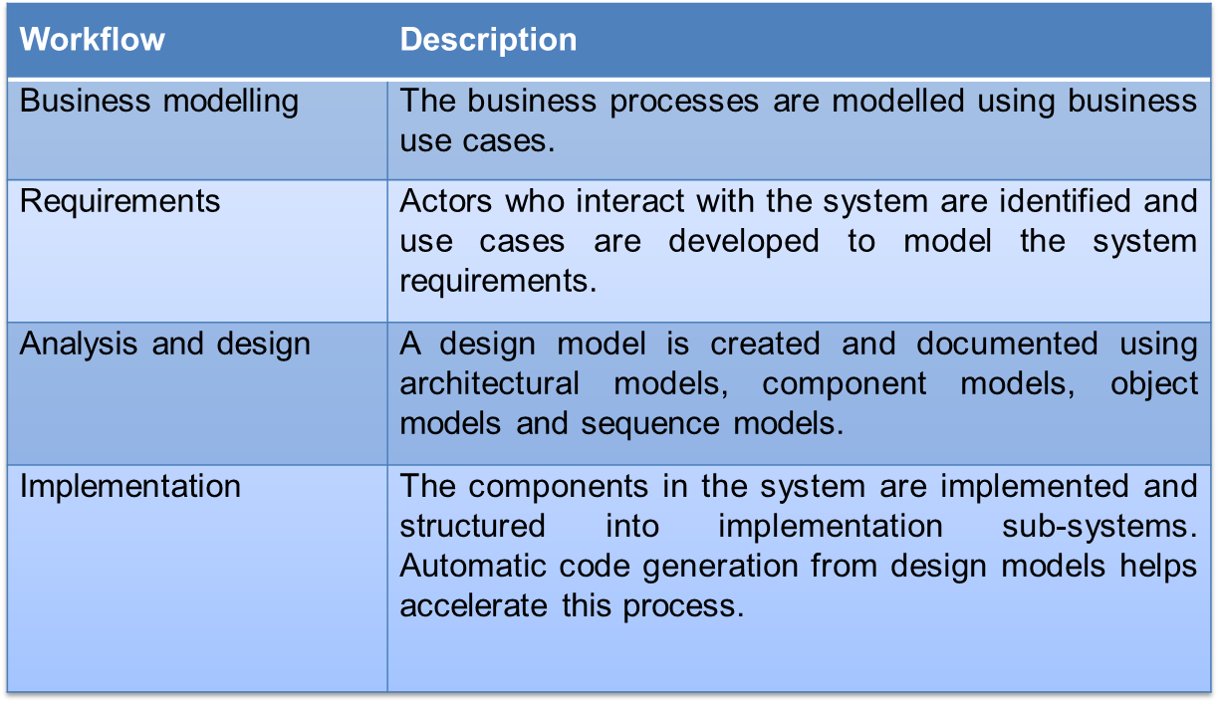
Static workflows in the Rational Unified Process

Slide 6
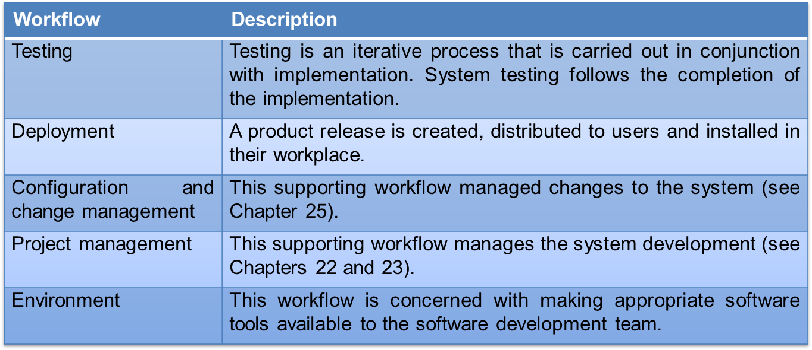
Static workflows in the Rational Unified Process

Slide 7
RUP good practice
Develop software iteratively
  Plan increments based on customer priorities and deliver highest priority increments first.
Manage requirements
  Explicitly document customer requirements and keep track of changes to these requirements.
Use component-based architectures
  Organize the system architecture as a set of reusable components.

Slide 8
RUP good practice
Visually model software
  Use graphical UML models to present static and dynamic views of the software.
Verify software quality
  Ensure that the software meet’s organizational quality standards.
Control changes to software
  Manage software changes using a change management system and configuration management tools.

Slide 9
Key points
Processes should include activities to cope with change. This may involve a prototyping phase that helps avoid poor decisions on requirements and design.
Processes may be structured for iterative development and delivery so that changes may be made without disrupting the system as a whole.
The Rational Unified Process is a modern generic process model that is organized into phases (inception, elaboration, construction and transition) but separates activities (requirements, analysis and design, etc.) from these phases.

